Slide 1
PERISCOPING THE KEY COMPONENTS OF A PEER REVIEW ARTICLE: A LEAD TO GETTING PUBLISHED IN LIS
BY
Dr. Chigozie S. Ugwuona, for NLA- FCT QUATERLY GENERAL MEETING HOLDING TODAY, 02 August, 2022 at the Boardroom of the national library of Nigeria, Abuja.

Slide 2
* Recognitions
Preliminary considerations:
- Why are we involved in research?
- Why the need to publish?
- How does one start to publish?
- What are the primary issues?

Slide 3
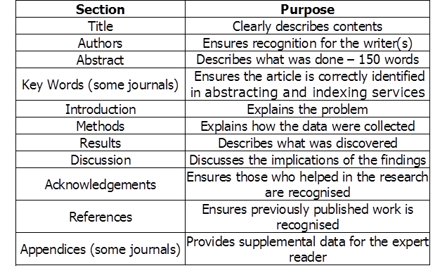
General format of a manuscript for peer review:

Slide 4
OTHER CONSIDERATIONS IN ADDITION TO THE GENERAL FORMAT
Disclosure of Conflict of Interest
Acknowledgment of funding sources
Image manipulation guidelines
Online submission - supplemental information (datasets, videos)
For Health Sciences: - Submission of a Clinical Trials to a Central Registry
- Institutional Review Board approval

Slide 5
THE COMPONENTS OF AN ARTICLE INTENDED FOR PUBLICATION
1. Introduction:
- Background of the study
- Statement of the problem
- Objective/s or Purpose of the study
- Scope
- Limitations (where applicable)

Slide 6
2. Literature review
- Conceptual framework (need to define and explain all concepts in the study)
- Theoretical framework (an over view of the subject leading to the identified problem). Discuss the variables in the study.
- Empirical studies – give report on some scholarly works done already in the study area.
- Summary (should show any existing vacuum the study would fill).

Slide 7
3. Research method – (Methodology)
Design
Area of study
Population
Sample and Sampling technique
The research instrument
Decision rule/precautions **validation **reliability
Method of data collection
Method of data analyses
Provide the reader enough details so that they can understand and replicate your research; Explain how you studied the problem, identify the procedures you followed, and order these chronologically where possible; Explain new methodology in detail; otherwise name the method and cite the previously published work

Slide 8
4. Presentation of result/s (NOT presentation and discussion of result).
State how results are presented in the study (In tables, graphs, bar chart, histogram, Pie chart, a model (then name the model) etc
Show the result in order of the research questions talking to the objectives of the study. Objectively present your findings, and explain what was found
Show what your new results are contributing to the body of scientific knowledge
Follow a logical sequence based on the tables and figures presenting the findings to answer the question or hypothesis raised in Introduction section.

Slide 9
5. Discussion of findings and conclusion
Relate discussions to objectives as they apply to determine the behavior of the research findings
Bring up clearly, the new findings making any great difference with the reviewed literature
State implication/s (+ or -) of the research results and summarize findings.
Conclude the article with critical findings made, where study could be applied and relevance of the findings in general, to persons, government, institutions, a population or group of certain interest.

Slide 10
6. References
Decision on how to write out References starts from the beginning by following the author instructions given by the journal you intend to publish in. Read it up and get conversant with such, before action.

Slide 11
Ending note
We and you will get it right one day by continuous and sustained effort. No one, is an Island but Remember
Jack Canfield’s words “do not worry about failures, worry about the chances you missed when you did not try”
Thank you for your patience to listen.

Slide 12
Bibliography
https://en.wikipedia.org/wiki/grant_writing
http://study.com/articles/howtobecomeagrantwritereducationandcareerroadmap.html
http://writingcenter.tamu.edu/2022/how-to/research-documentation/documenting-sources/
Powell, R. Ronald and Connaway, Lynn Silipigni (2004) Basic Research
Methods for Librarians, Libraries Unlimited, Connecticut.

